Slide 1
Excel Final Assessment
Final

Slide 2
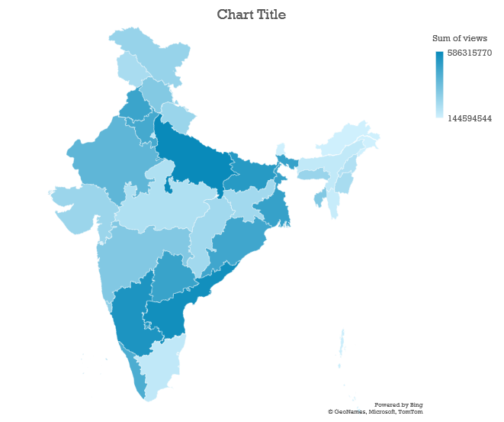
Q.16

Slide 3
Q.18 Channel Name: ThanthiTV

Slide 4
Q.19

